Slide 1
The compelling offer
How the market should meet the nZEB needs and desires of private homeowners
Peter Rathje
Refurb Compelling Offer, Coordinator

Slide 2
The Refurb Scope
Increase energy performance of existing buildings by removing non-technical barriers
Inspire homeowners to carry out deep energy renovations
Creating an easy, affordable and safe journey
nZEB (deep renovations) – implemented in a step-by-step approach
Improve energy efficiency by 50-80%
Bridging demand and supply side, promoting one-stop-shop solutions

Slide 3

Connecting society goals and ambitions

Slide 4
The Refurb project structure
Analysis of the DEMAND side
Making a package
”on time” attractive to a specific segment and realize it!
Delivery & Quality Assurance
Compelling offers
Analysis of the SUPPLY side
Local pilots
Roll-out and replication plan
Transferability potential

Slide 5
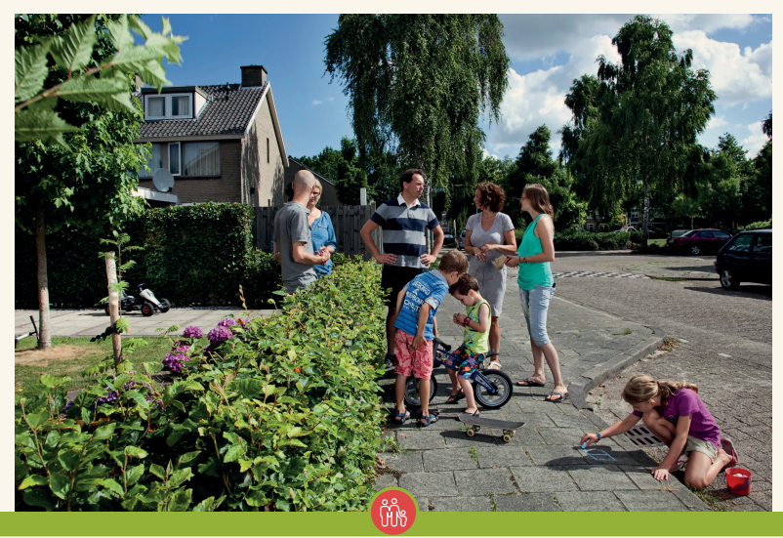
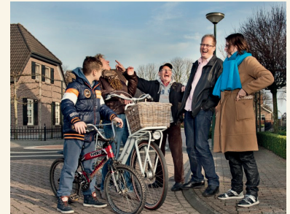
How to create a Refurb compelling offer in only six steps
Focus your market segment ex. Young Families (YF) or Empty Nesters (EN) in single detached homes
Use the customer journey to identify the stumbling blocks and advantages/actions?
Generate the value proposition
Describe the business model
Add the financial support (optional)
Appoint a Single point of contact (if required)

Slide 6

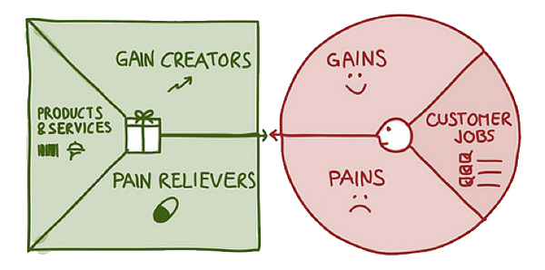
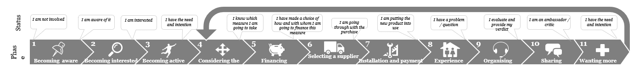
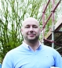

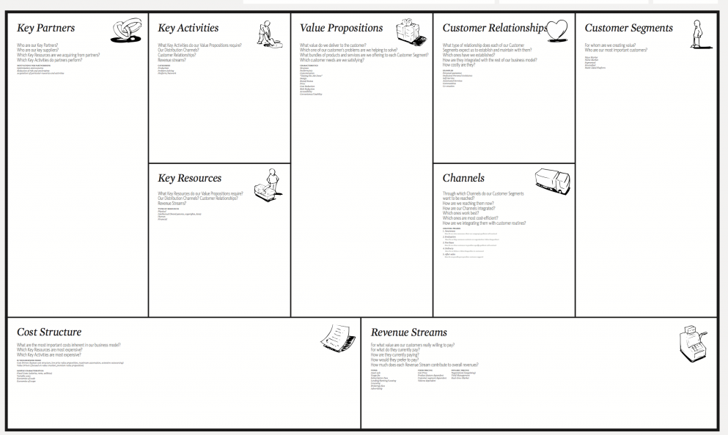
(3) To get home-owners on board the journey, you need a value proposition
+
(5) Financial support & incentives
will improve !
(2) The Refurb Customer Journey with pre-programmed QA
creates a common understanding and platform
(6) To keep the journey powered,
you need a single point of contact
(4) The value creating business model
will secure strong stakeholder engagement

Slide 7
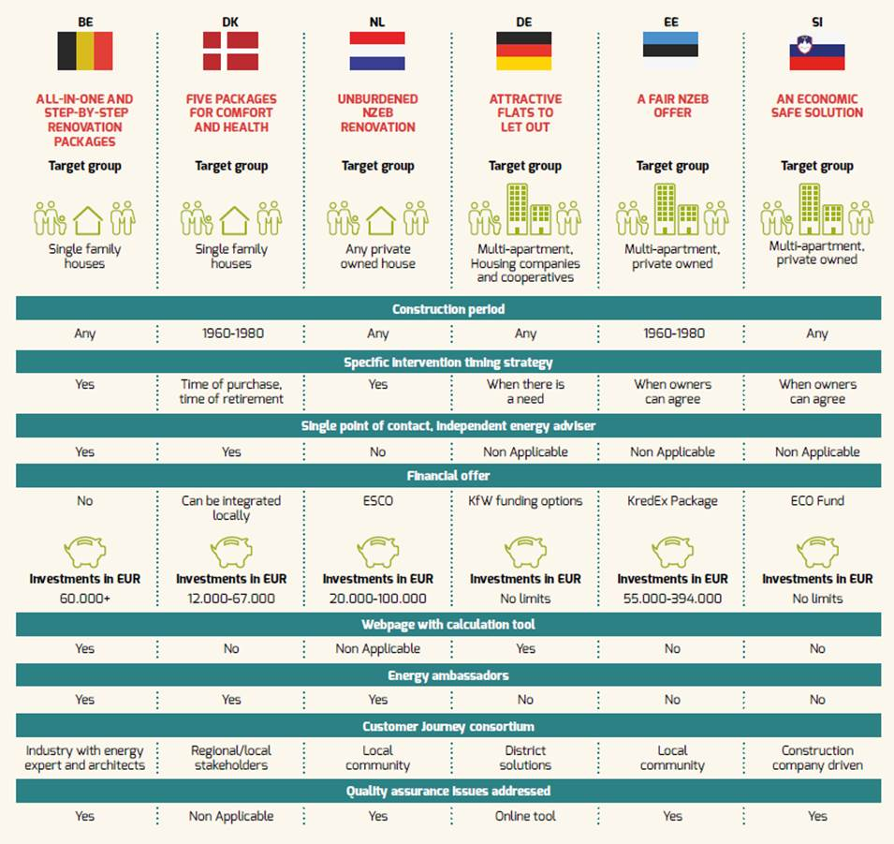
Country specific Refurb-offers

Slide 8
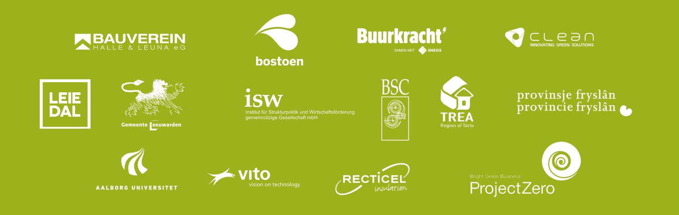
Created by 14 European Partners
from 6 countries
in close cooperation

Slide 9
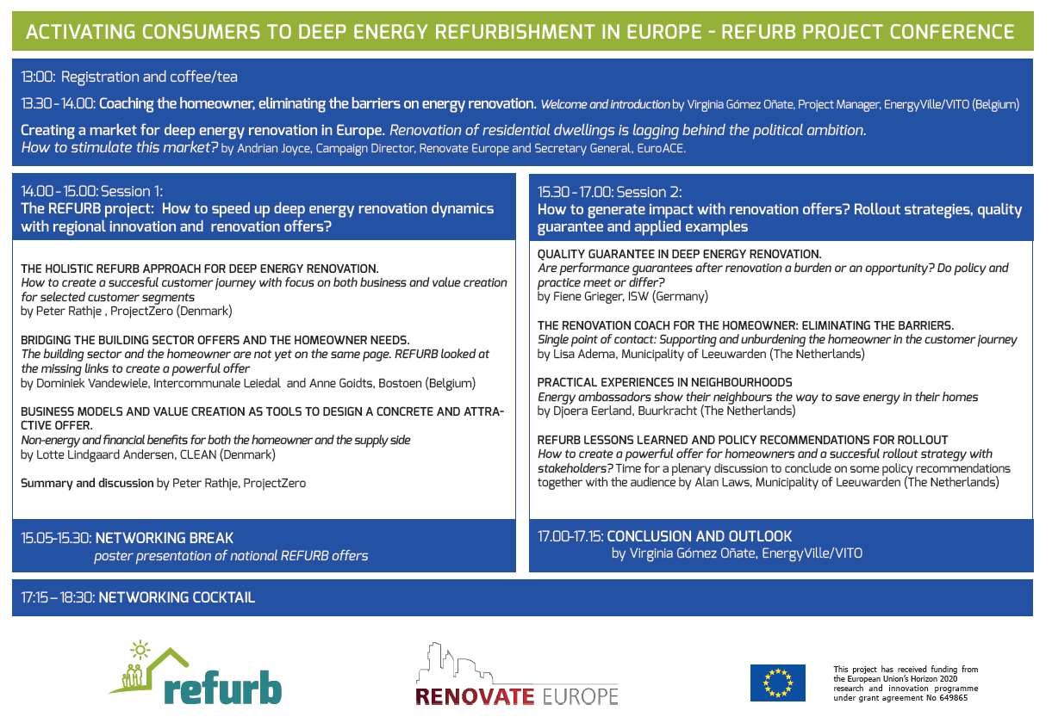
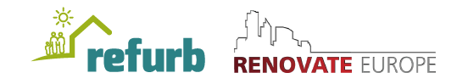
ACTIVATING CONSUMERS TO DEEP ENERGY REFURBISHEMENT IN EUROPE

